Slide 1
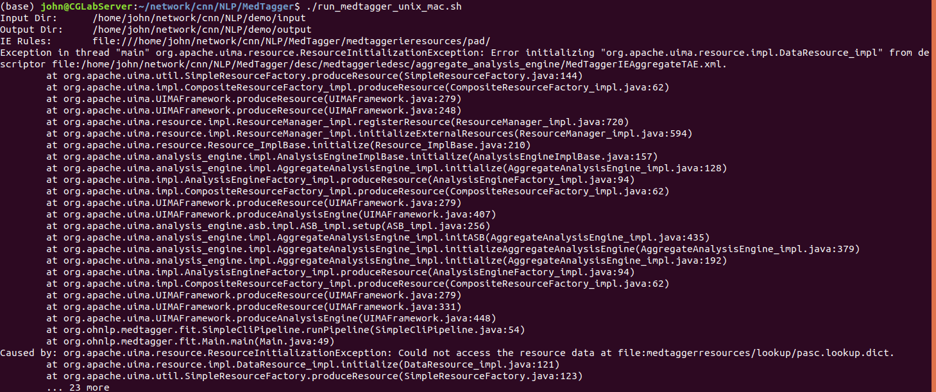
MedTagger [failed]
linux version

Slide 2
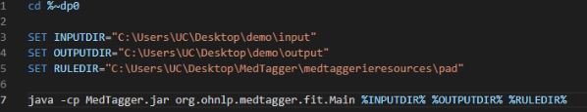
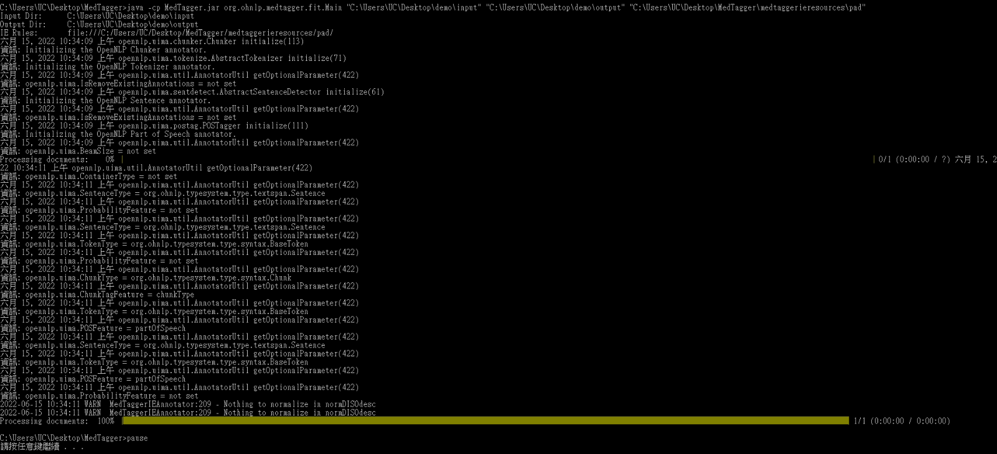
MedTagger
windows version
- env path config
- initialization demo input to output

Slide 3
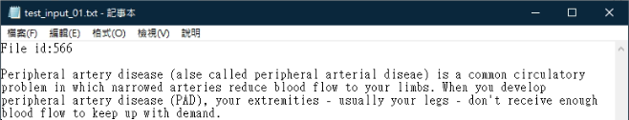
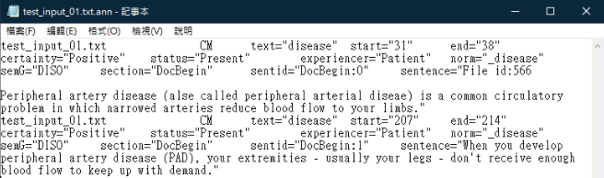
MedTagger - Demo 01 [Command test]
Input
Output

Slide 4
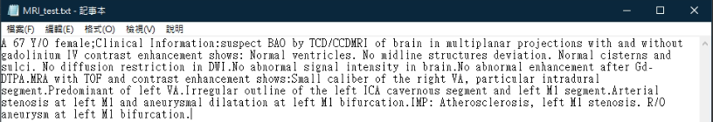
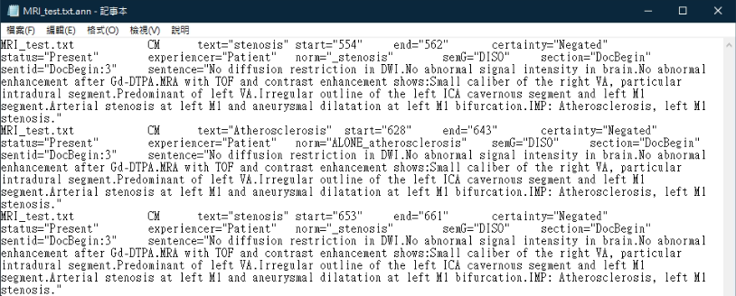
MedTagger - Demo 02 [Command test]
Input
Output

Slide 5
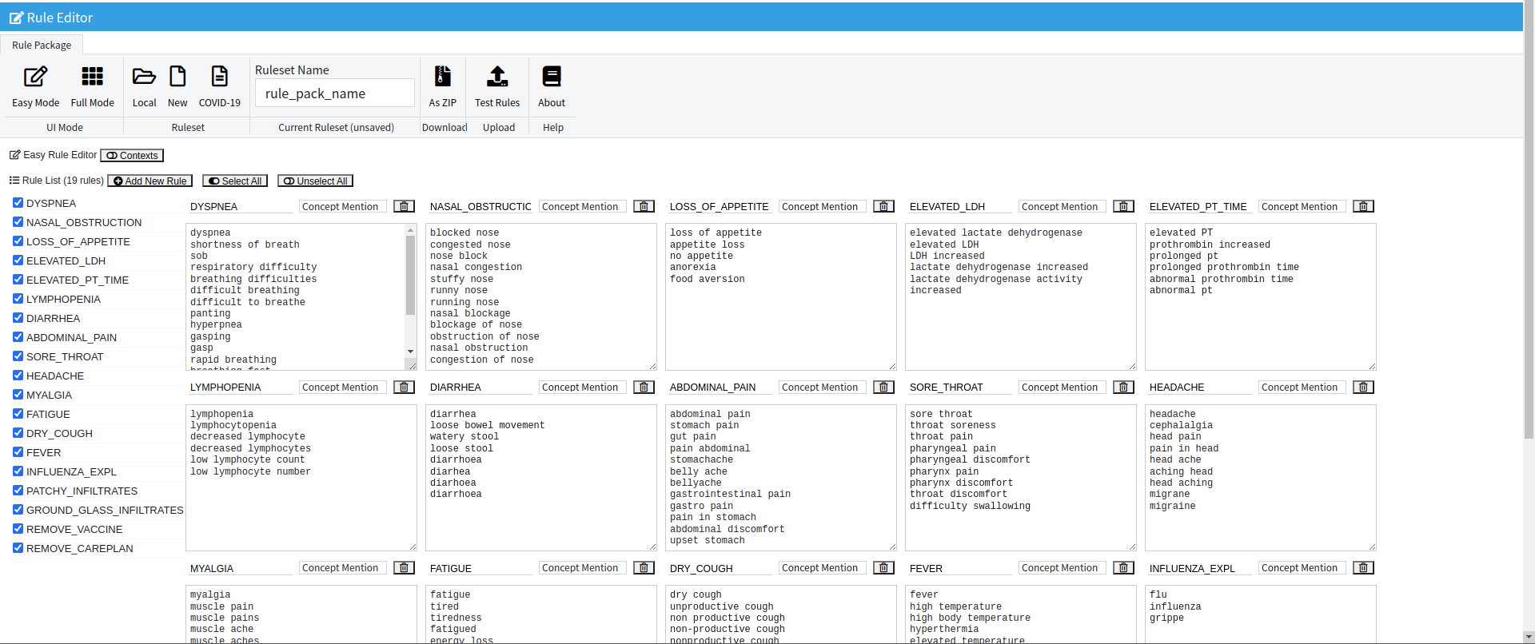
MedTagger - Online rule editer
https://ohnlp.github.io/ohnlptk/ie_editor.html

Slide 6
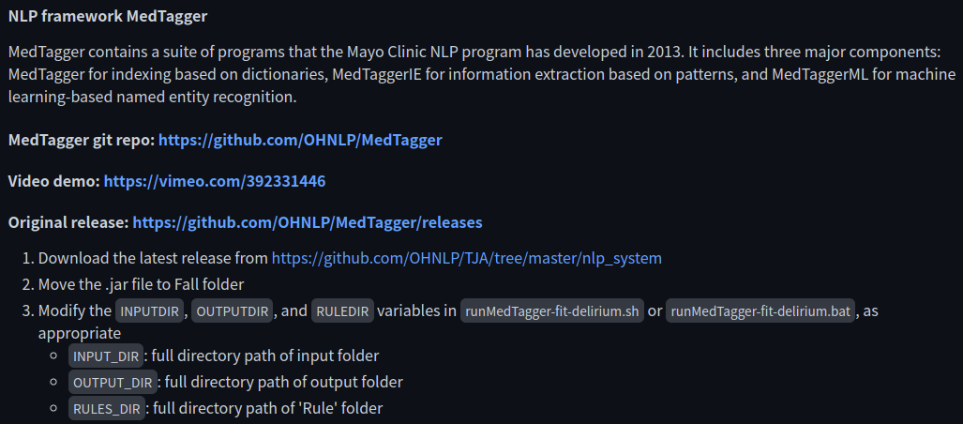
AgingNLP - Fall NLP Algorithm
windows version
No such file

Slide 7
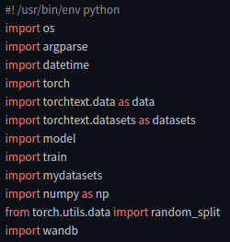
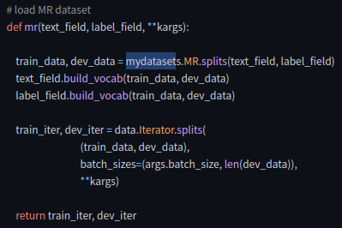
AgingNLP - Fall NLP Algorithm
No such file

Slide 8
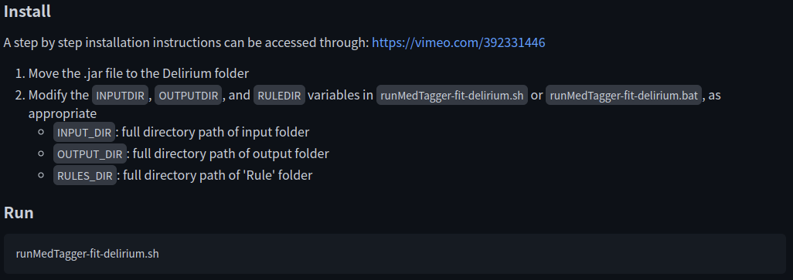
AgingNLP - Delirium NLP Algorithm
windows version
No such file
No such file

Slide 9
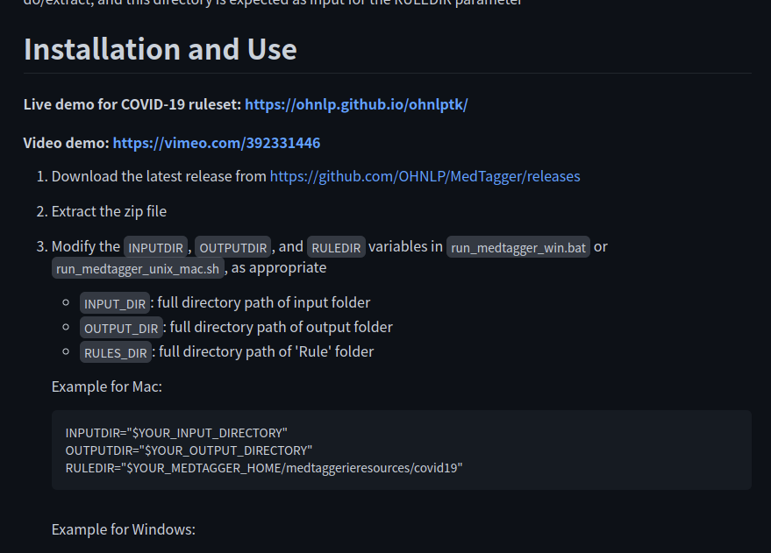
MedTagger

Slide 10
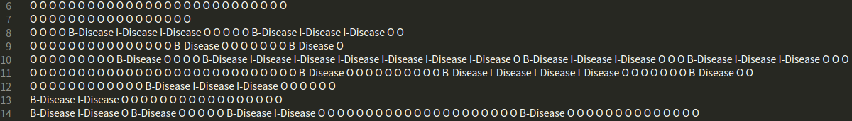
NeMo - Data [Mask & Raw Data]
https://github.com/NVIDIA/NeMo <-
Mask - 3 Class [0:O, 1:B-Disease, 2:I-Disease]
Raw Data

Slide 11
NeMo - Demo Train & Test Result
Demo Code [python] <-
epoch | gpus num | train data num | test data num
5 | 1 [1080Ti] | 5430 | 940
Class | Precision | Recall | F1-Score
O | 99.33 | 99.62 | 99.47
B - Disease | 89.00 | 90.47 | 89.73
I - Disease | 95.56 | 88.90 | 92.11
accuracy | 98.83 | 98.83 | 98.83
macro avg | 94.63 | 92.99 | 93.77
weighted avg | 98.82 | 98.83 | 98.82

Slide 12

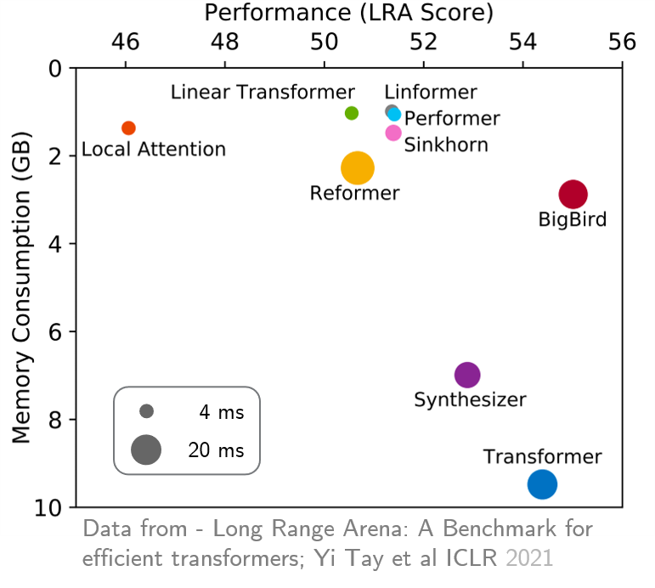
BigBird Bio-NLP

Slide 13
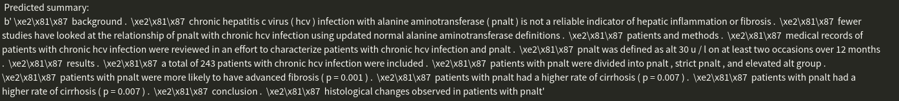
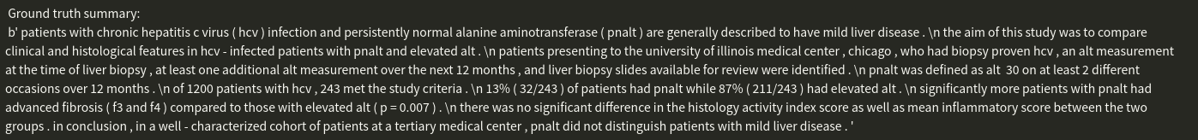
BigBird Bio-NLP - Demo Results
Demo Code [python] <-

Slide 14
